Slide 1
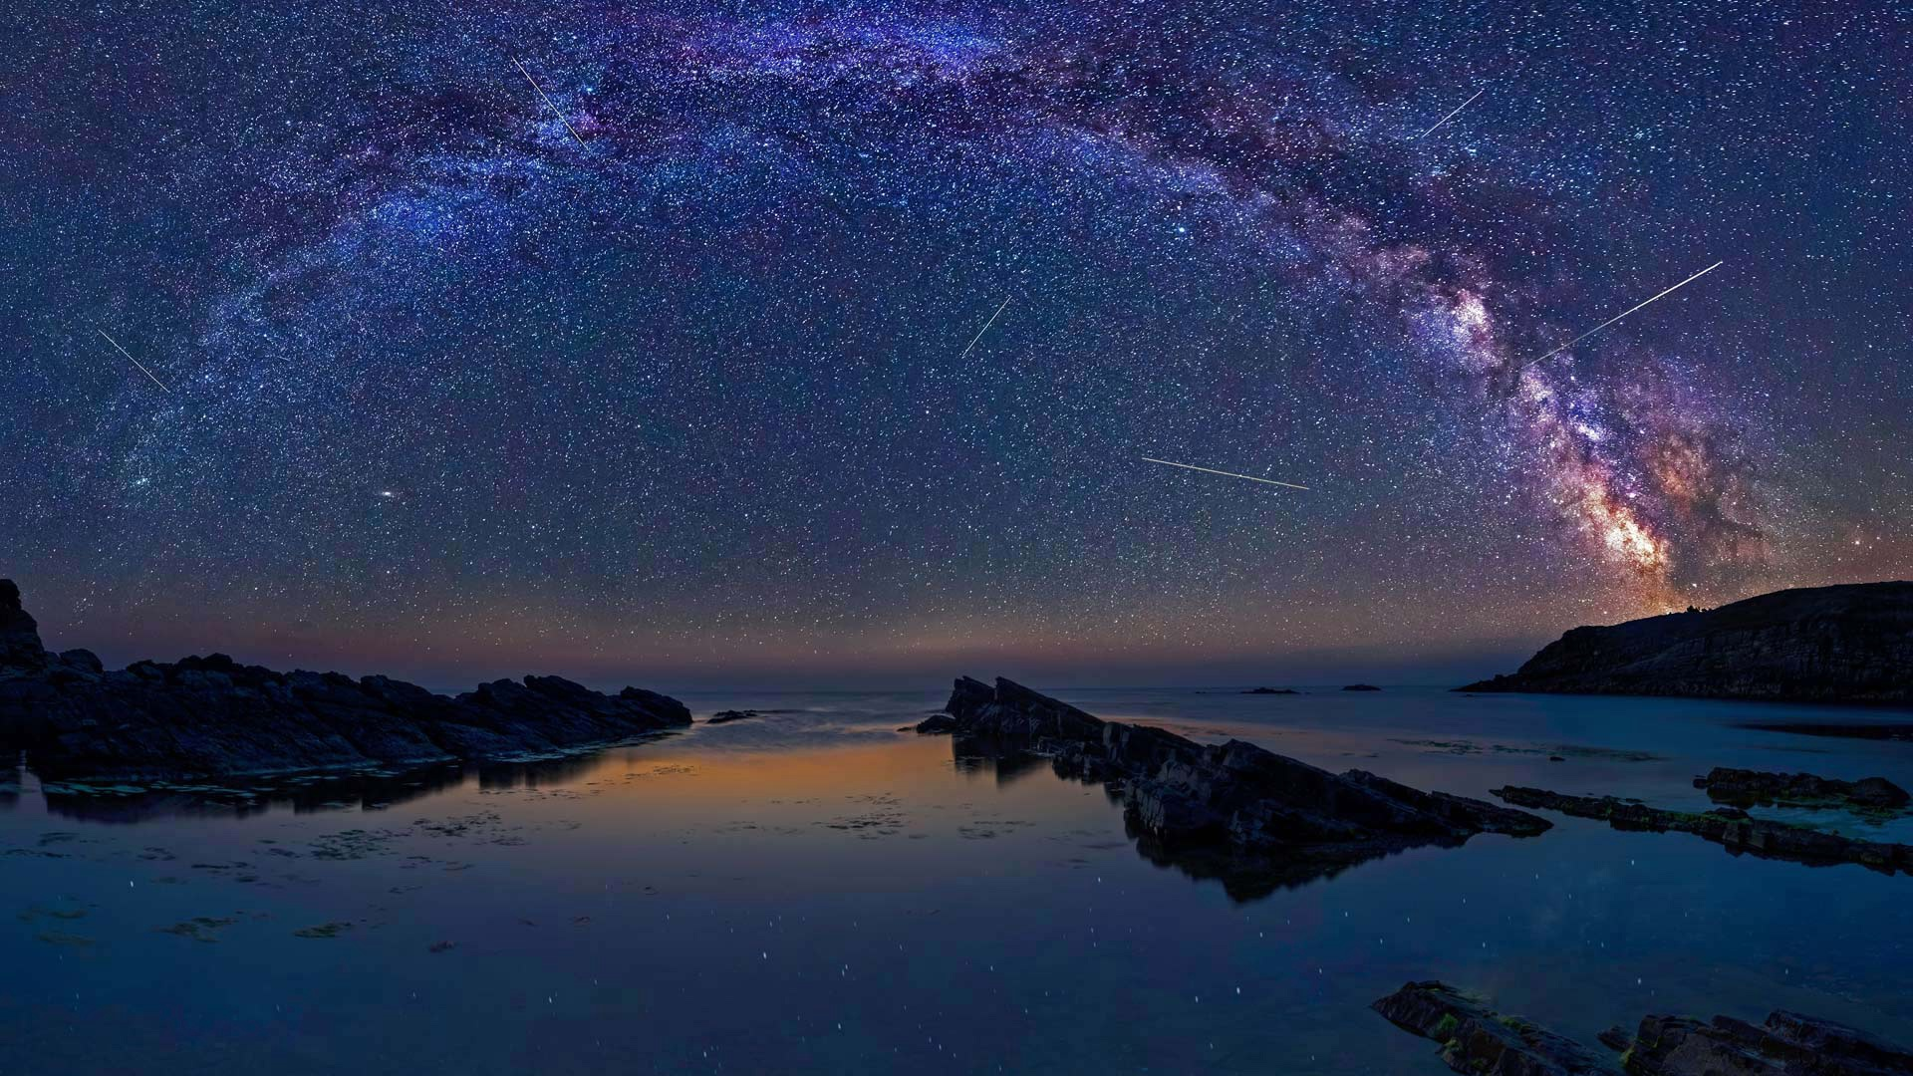
Navigating the Sky

Slide 2
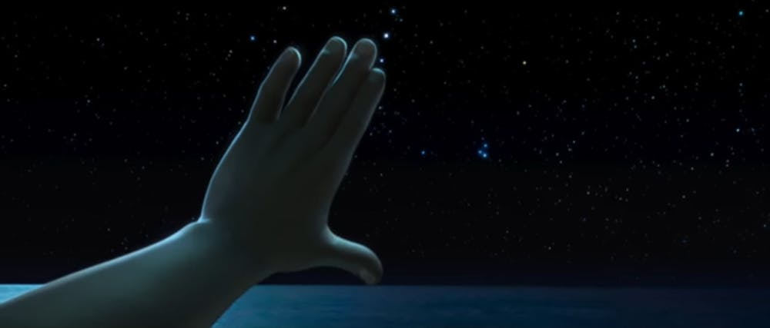
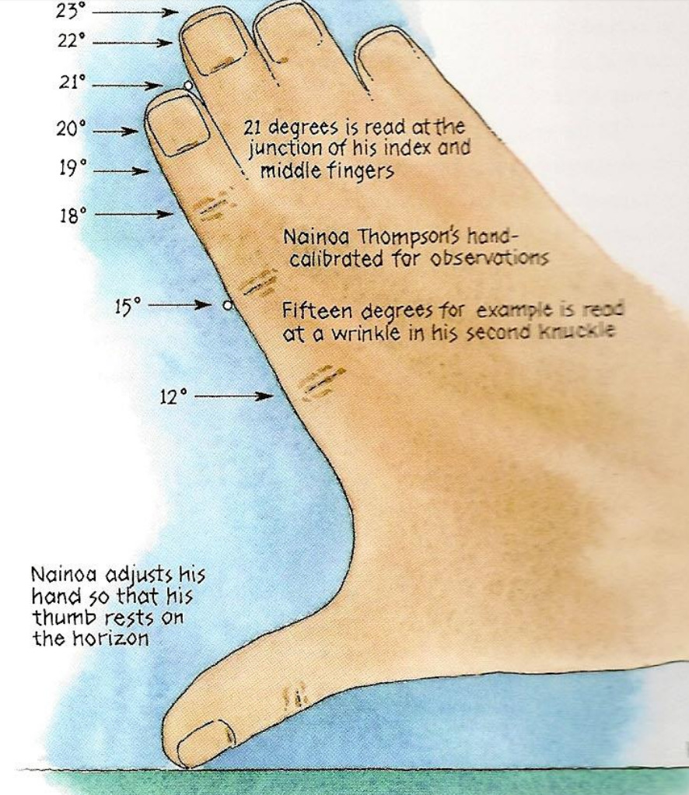
https://www.youtube.com/watch?v=ubZrAmRxy_M

Slide 3
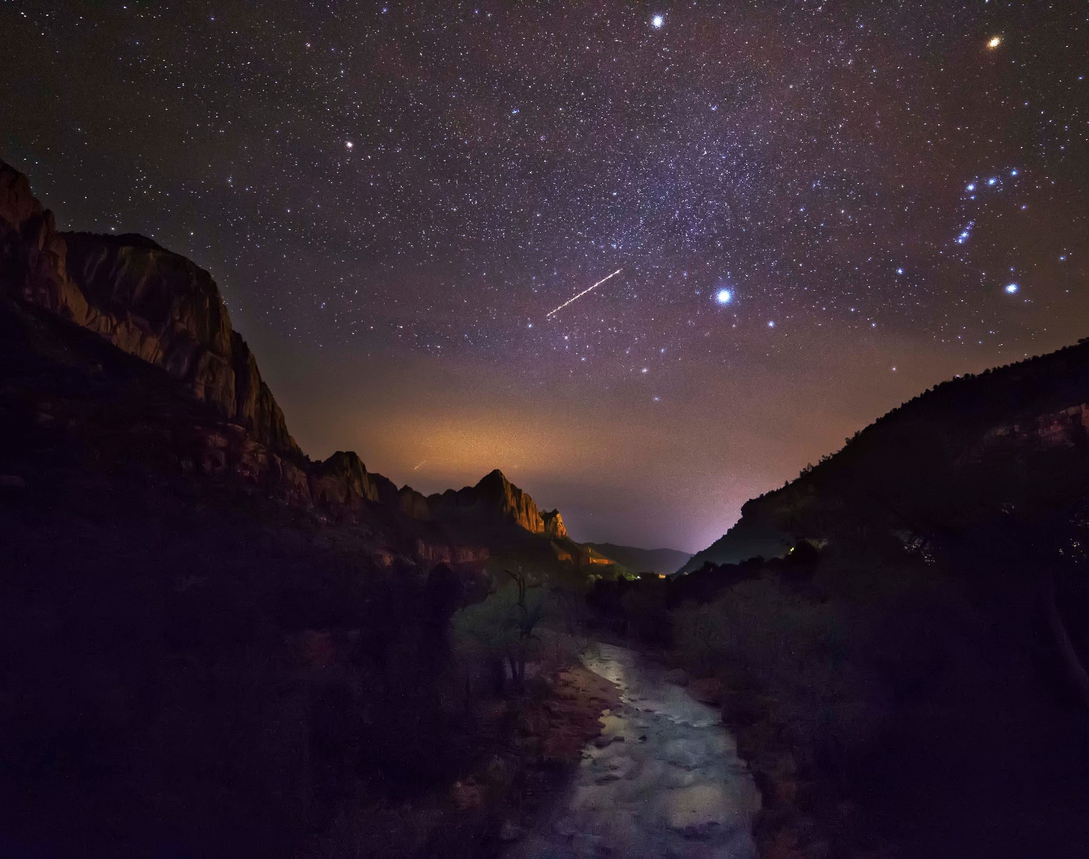
Compared to a star with an apparent magnitude of 6, a star with an apparent magnitude of -1 is
Brighter
Dimmer
More massive
Less massive

Slide 4
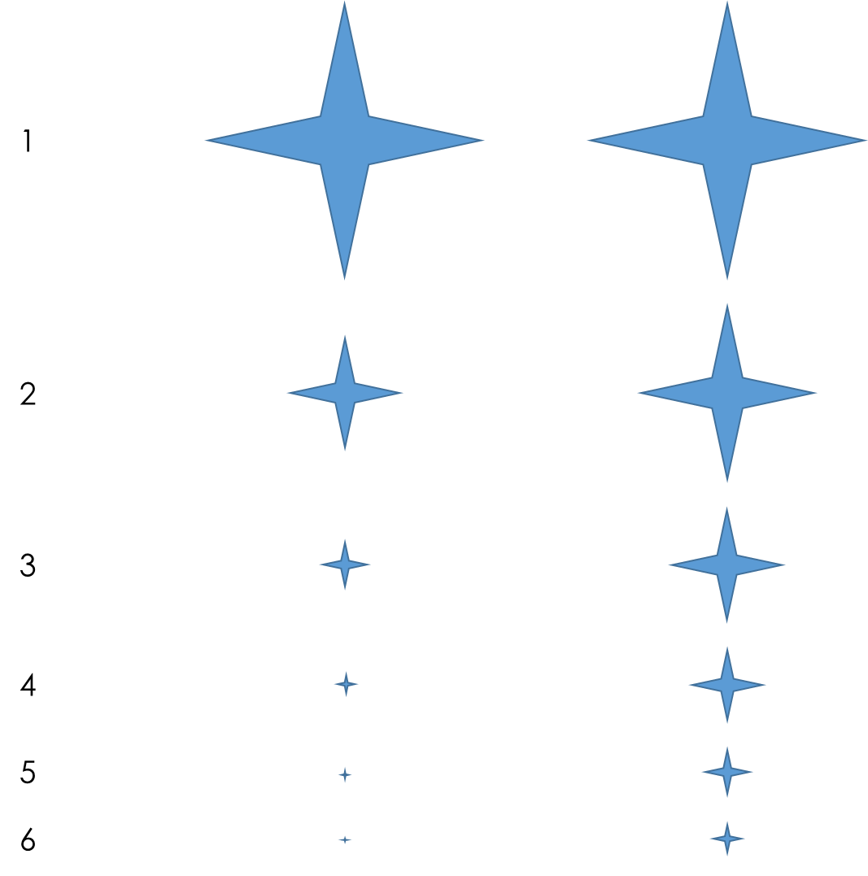
Compared to a star with an apparent magnitude of 6, a star with an apparent magnitude of -1 is
True
Relative
Brightness
Perceived
Relative
Brightness
Magnitude
Brighter

Slide 5
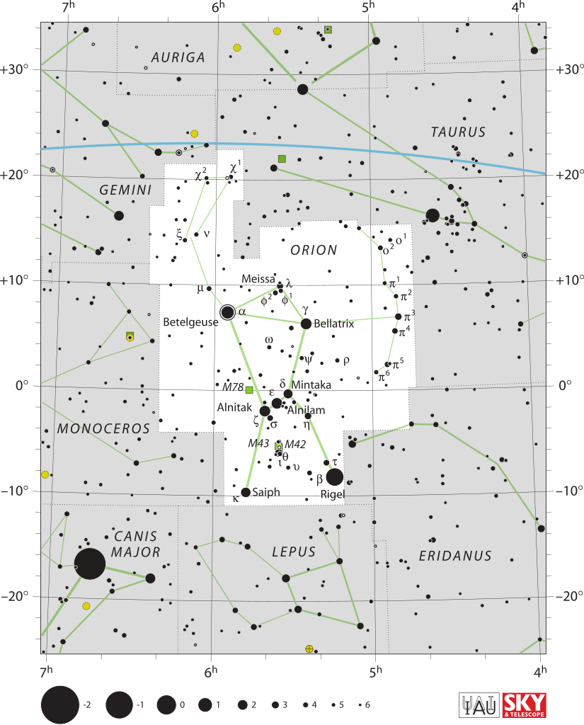
Compared to a star with an apparent magnitude of 6, a star with an apparent magnitude of -1 is
Brighter

Slide 6
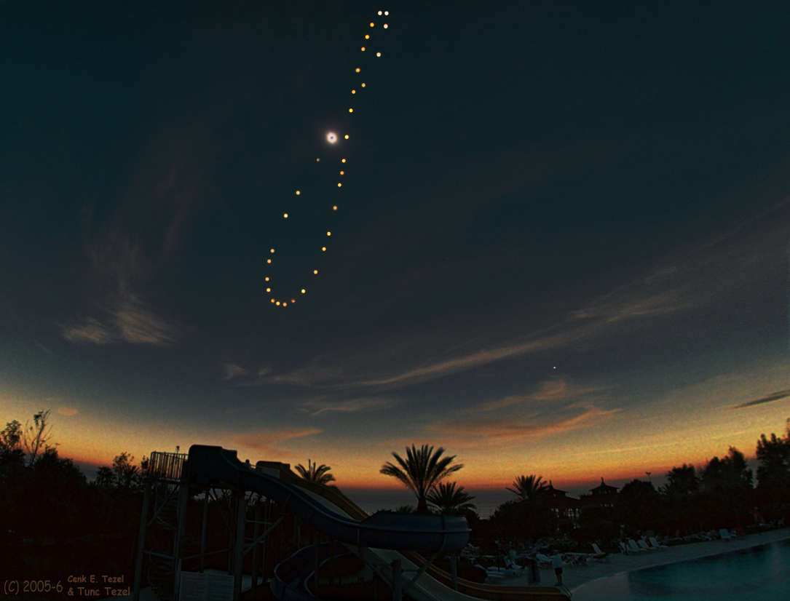
The Sun crossing the celestial equator marks the beginning of what season?
Spring
Summer
Autumn
Winter

Slide 7
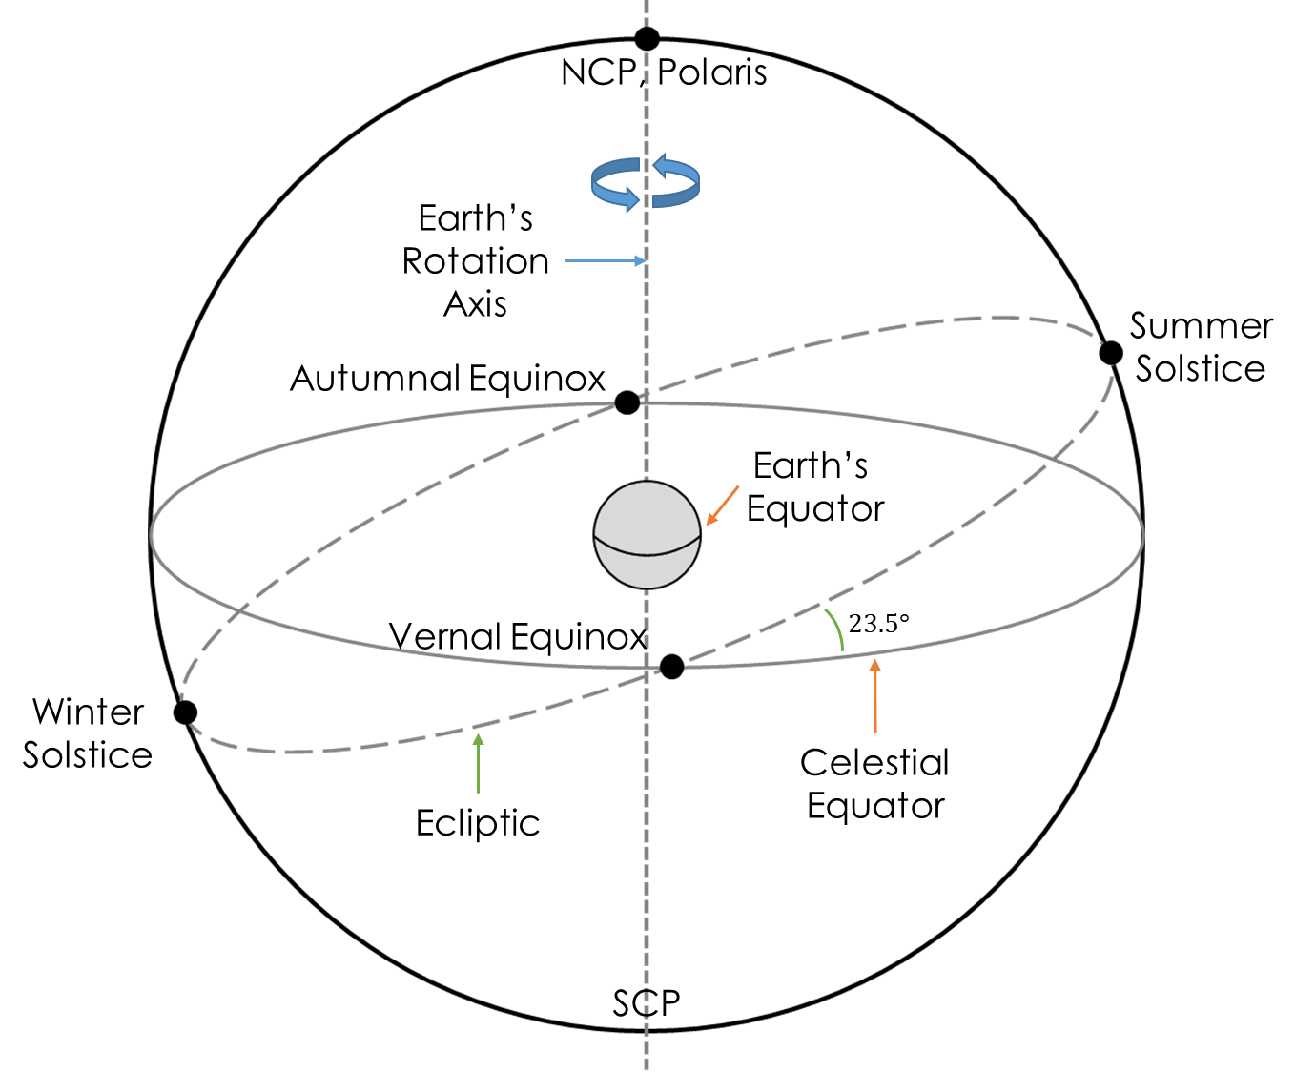
The Sun crossing the celestial equator marks the beginning of what season?
Spring
Autumn

Slide 8
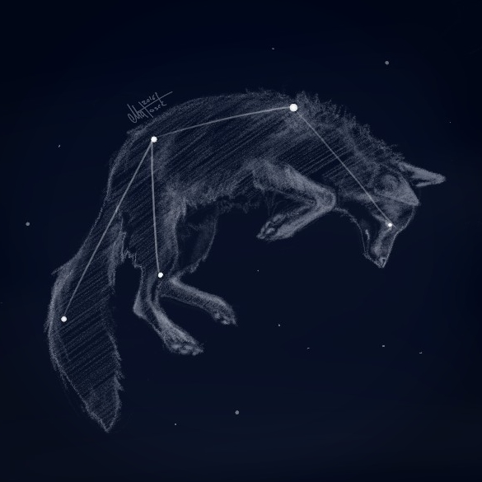
If it is July 21st, is a constellation at RA = 20h up during the day or the night?
Vulpecula

Slide 9
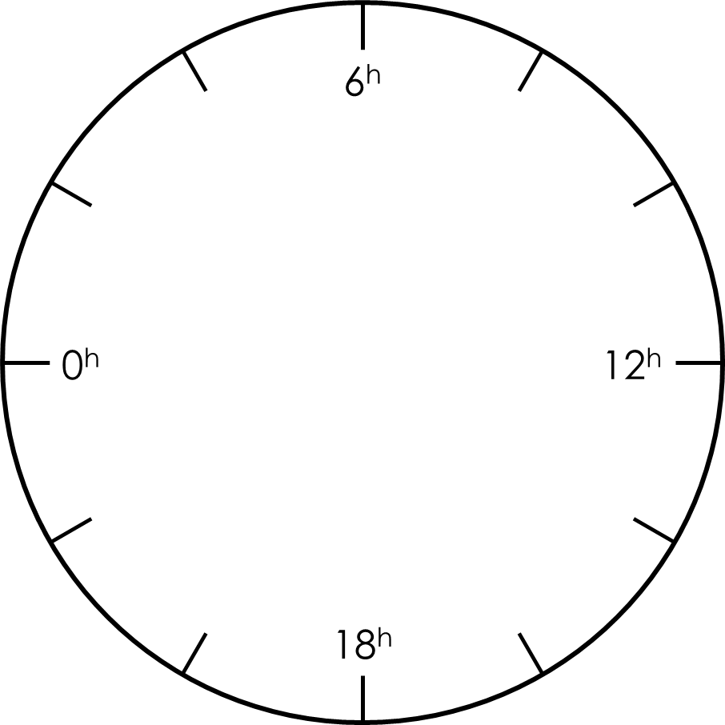
Summer
Solstice
Vernal
Equinox
Autumnal
Equinox
Winter
Solstice

Slide 10
~Jun 20

Slide 11
~Jun 20
24^{h} / year
------------------------
12 months / year
=
2^{h} / month

Slide 12
RA = 8^{h}
~July 20
24^{h} / year
------------------------
12 months / year
=
2^{h} / month

Slide 13


RA = 8^{h}
RA = 20^{h}

Slide 14

RA = 8^{h}
RA = 20^{h}

Slide 15
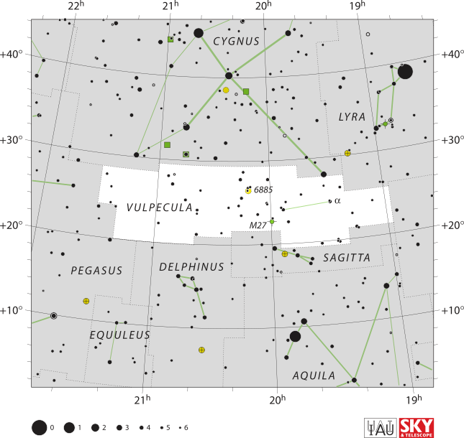
If it is July 21st, is a constellation at RA = 20h up during the day or the night?
Summer
Triangle
At Night

Slide 16
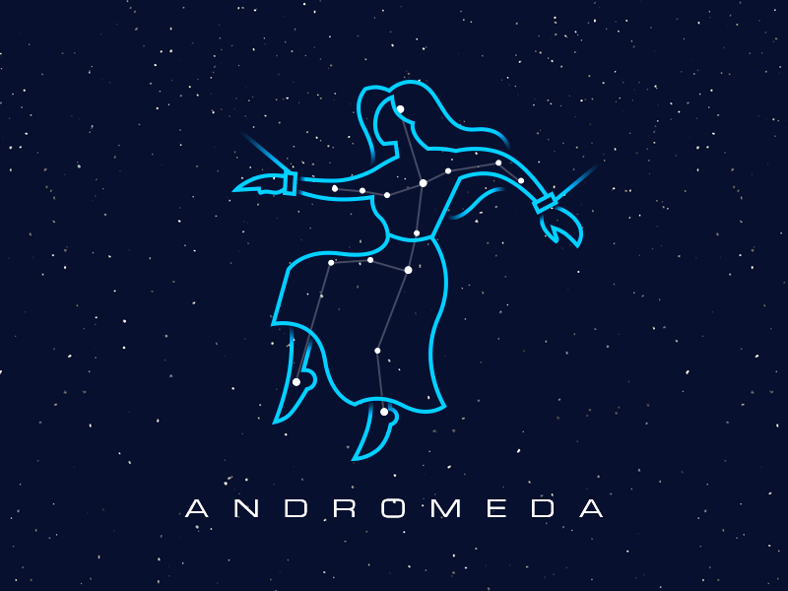
When is a constellation at RA = 0h up at midnight?

Slide 17


Slide 21
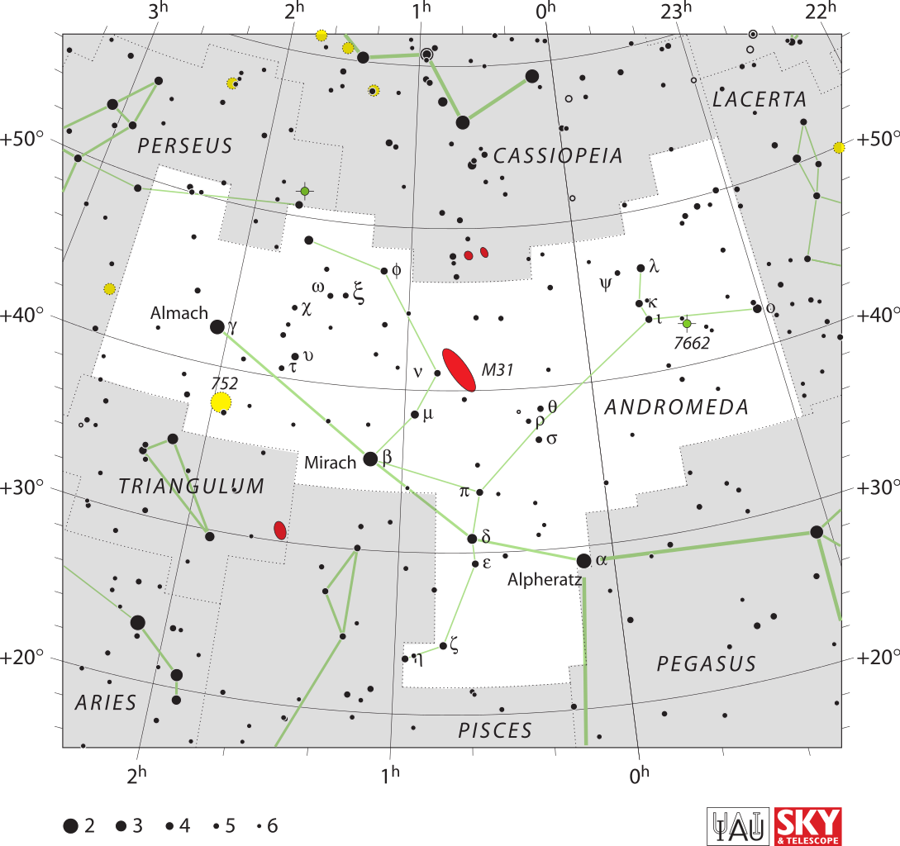
When is a constellation at RA = 0h up at midnight?
Summer & Autumn

Slide 22
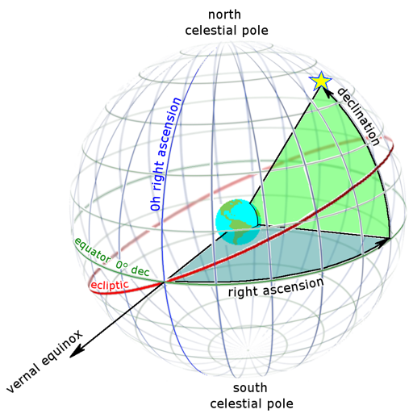
Equatorial Coordinates
Right Ascension
Angular distance along the celestial equator measured eastward from the Vernal Equinox
Declination
Angular distance above the celestial equator

Slide 23
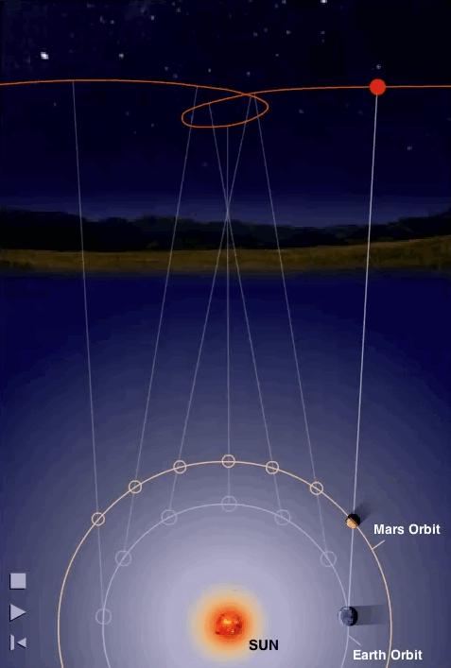
RA
East
West
Right Ascension – angular distance along the celestial equator measured eastward from the Vernal equinox

Slide 24
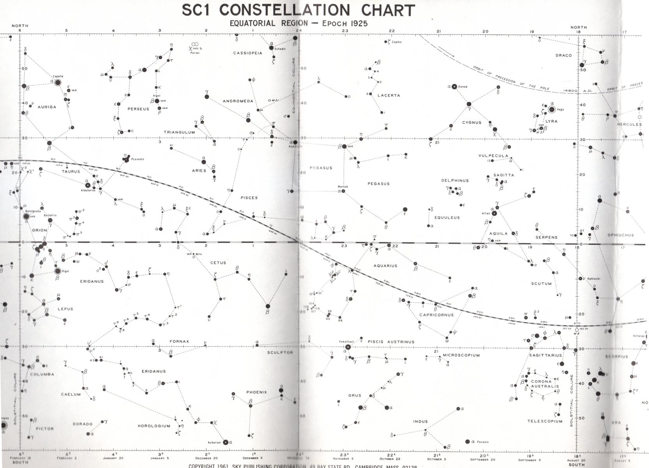
Declination
Right Ascension

Slide 25
Declination
Right Ascension

Slide 26
Declination
Right Ascension

Slide 27
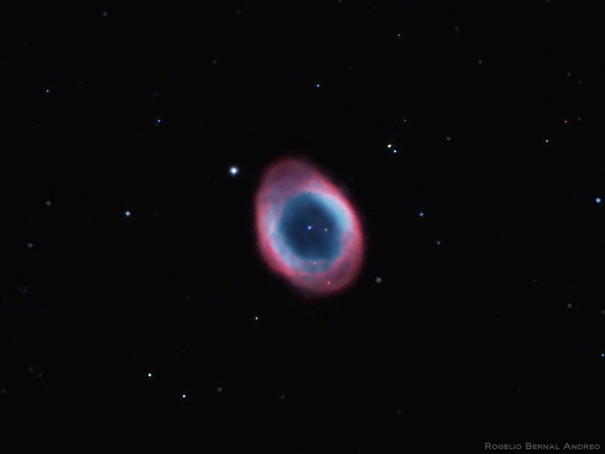
M57 – Ring Nebula
Constellation: Lyra
Declination
Right Ascension

Slide 28
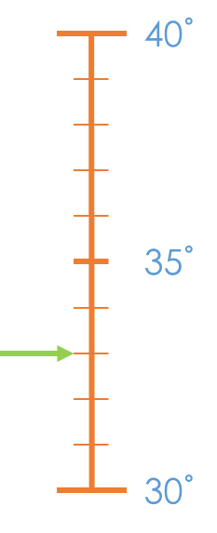

M57 – Ring Nebula
Constellation: Lyra
Declination
$δ≈33°$
Declination
Right Ascension

Slide 29
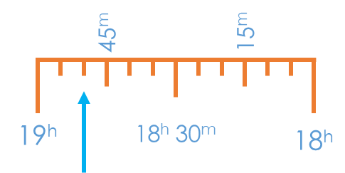

M57 – Ring Nebula
Constellation: Lyra
Declination
Right Ascension
$α≈18h 50m$
Right Ascension

Slide 30


M57 – Ring Nebula
Constellation: Lyra
Right Ascension
$α≈18h 50m$
Declination
$δ≈33°$
Declination
Right Ascension

Slide 31
Declination
Ecliptic
Right Ascension

Slide 32
Dates
Declination
Ecliptic
Right Ascension

Slide 33
Declination
Jan 20
Ecliptic
Right Ascension

Slide 34
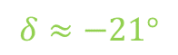
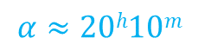
Declination
$$δ≈−21°$$
Ecliptic
$$α≈20h10m$$
Right Ascension

Slide 35
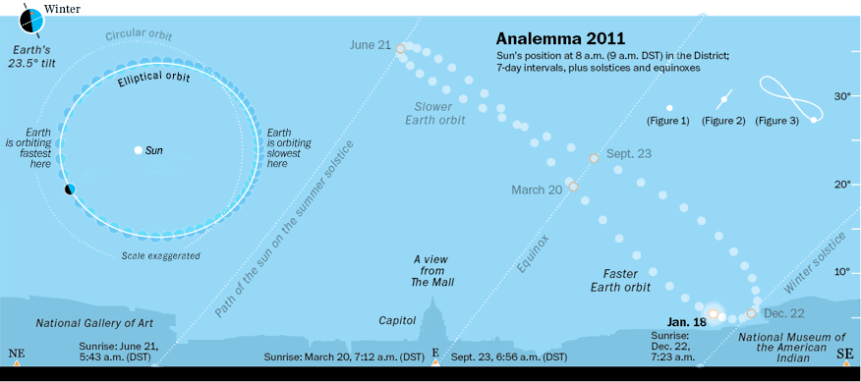

Slide 36
Declination
Dates
Right Ascension

Slide 37
Declination
Local Meridian
@ 8 pm
Standard Time
(9 pm Daylight
Savings)
Dates
Right Ascension

Slide 38
Declination
Local Meridian
@ 8 pm
Standard Time
(9 pm Daylight
Savings)
Jan 20
Right Ascension

Slide 39
Declination
Meridian @ 8 pm
RA = 4^{h}
(Standard Time)
Local Meridian
@ 8 pm
Standard Time
(9 pm Daylight
Savings)
Jan 20
Right Ascension

Slide 40
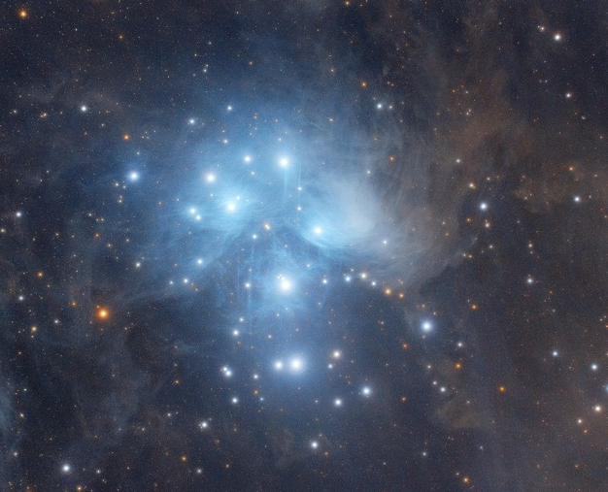
Pleiades
Declination
Meridian @ 8 pm
RA = 4^{h}
(Standard Time)
Local Meridian
@ 8 pm
Standard Time
(9 pm Daylight
Savings)
Jan 20
Right Ascension

Slide 41
Declination
Meridian @ 8 pm
RA = 4^{h}
(Standard Time)
Local Meridian
@ 8 pm
Standard Time
(9 pm Daylight
Savings)
Jan 20
Right Ascension

Slide 42
Declination
+1 hour
Meridian @ 9 pm
RA = 5^{h}
(Standard Time)
Local Meridian
@ 8 pm
Standard Time
(9 pm Daylight
Savings)
Jan 20
Right Ascension

Slide 43
Declination
+2 hour
Meridian @ 10 pm
RA = 6^{h}
(Standard Time)
Local Meridian
@ 8 pm
Standard Time
(9 pm Daylight
Savings)
Jan 20
Right Ascension

Slide 44



S

Slide 45

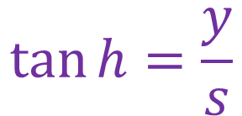


$$\tan{h}=\frac{y}{s}$$
$$h$$
$$y$$
$$s$$

Slide 46
45^{m}
15^{m}
19^{h}
18^{h} 30^{m}
18^{h}

Slide 47
6^{h}
0^{h}
12^{h}
18^{h}

Slide 49
1
2
3
4
5
6

